Slide 1
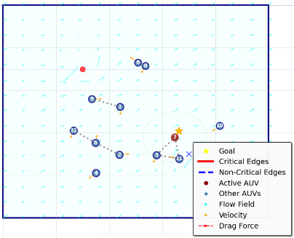
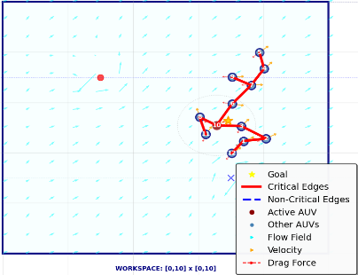
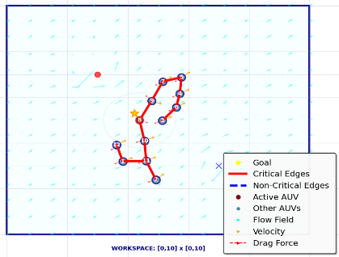
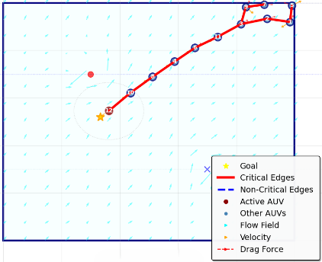
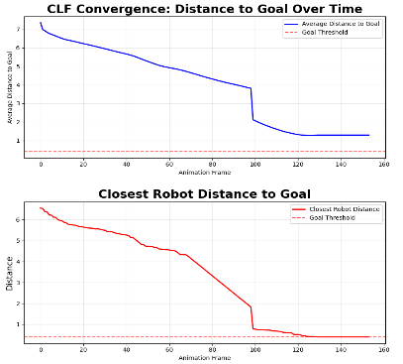
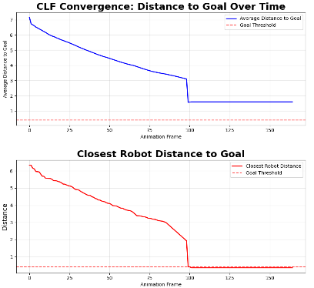
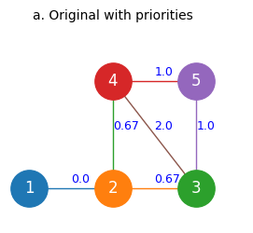
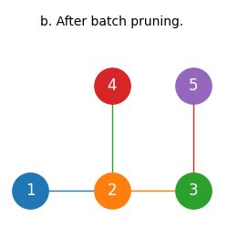
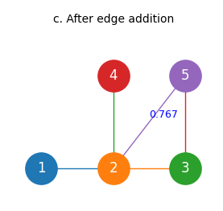
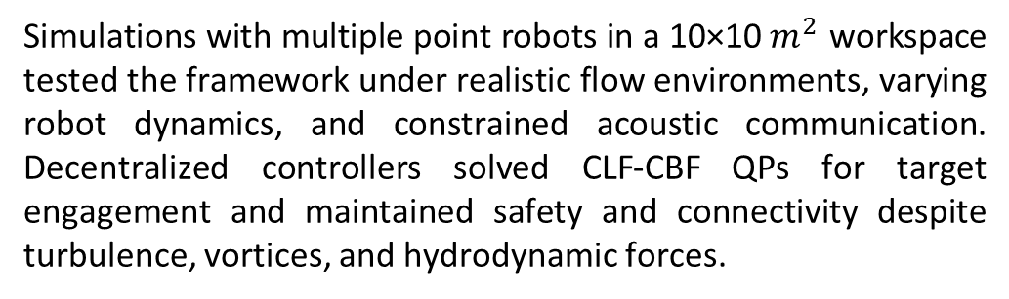


Distributed Control Framework for Connectivity Preservation and Collective Reconfiguration in Flow-Driven Robot Fleets
Prajjwal Dutta and Xi Yu
Ira A. Fulton Schools of Engineering
School of Manufacturing Systems and Networks
Problem
Methodology
Simulation
Underwater robots drift in dynamic flows and face dispersion that helps exploration but threatens network connectivity. Locations of interest are found only when sensed, requiring the team to maintain connectivity and sparstfy their communication graph while drifting. When a target is detected, some agents seek the goal and others relay to keep the fleet connected, all relying only on local state and neighbor exchanges. The challenge is to develop a fully distributed control method that preserves connectivity, leverages flow for energy efficiency, and enables coordinated reconfiguration when new targets appear, without any centralized coordination or global maps.
Edge Detection, Pruning, and Rewiring:
Each robot examines its local graph structure and prunes edges $\left(i , j\right)$ if their removal keeps the network connected, i.e., the graph remains a spanning tree. The minimum spanning structure can be characterized using local connectivity checks and weights:
$$G_{t}=\left(V , E_{t}\right), E_{t}=\left\{\left(i , j\right):w_{ij}<\text{threshold}\right\}$$
where $w_{ij}$ is the edge weight between robot $i$ and $j$, and pruning ensures:
$$G_{t+1} \text{is} \text{connected} \text{if} G_{t} \text{was} \text{connected} \text{and} \text{edge} \left(i , j\right) \text{removed} \text{is} \text{non}\text{−}\text{critical}$$
Rewiring activates when new connectivity must be established, restoring crucial links to maintain spanning properties.
Simulations with multiple point robots in a 10×10 $m^{2}$ workspace tested the framework under realistic flow environments, varying robot dynamics, and constrained acoustic communication. Decentralized controllers solved CLF-CBF QPs for target engagement and maintained safety and connectivity despite turbulence, vortices, and hydrodynamic forces.
Goals
This study proposes a distributed control approach for underwater robot fleets that must explore dynamic environments, detect new targets, and maintain a connected network with only local information. The main aims include:
Preserve network connectivity throughout exploration and target pursuit.
Minimize control effort use by leveraging flow and activating controls only when needed.
Enable robots to reconfigure for coverage and rapid response to new targets.
Operate using only local and neighbor information, with no centralized control.
The proposed control preserves connectivity, while uncontrolled robots fragment and disconnect.
Both centralized and decentralized approaches maintain connectivity and achieve similar team performance in target engagement.
Decentralized Control Barrier Functions
Control barrier functions ensure safety and connectivity between neighboring robots. For robot $i$ and neighbor $j$:
Safety:
$$h_{safe}^{ij}\left(x\right)=∥x_{i}−x_{j}∥^{2}−d_{min}^{2}>0$$
Connectivity:
$$h_{conn}^{ij}\left(x\right)=R_{max}^{2}−∥x_{i}−x_{j}∥^{2}>0$$
At each step, robots solve for control input $u_{i}$ satisfying:
$${\dot{h}}_{safe}^{ij}\left(x\right)+α\left(h_{safe}^{ij}\left(x\right)\right)≥0$$
$${\dot{h}}_{conn}^{ij}\left(x\right)+α\left(h_{conn}^{ij}\left(x\right)\right)≥0$$
Future Work
Connectivity and safety are preserved in flows.
Distributed control yields robust, adaptive teams.
Advance realistic dynamics and experiments.
Explore new topologies for advanced tasks.

